Slide 1

Interactive User Authenticator Security Agent Guarding RL-Powered Video Game
ELECTIVE IN ARTIFICIAL INTELLIGENCE
FINAL PROJECT
Iliya Ghotbi 1905527
Nijat Mursali 1919669
Mahammad Namazov 1904736

Slide 2
TABLE OF CONTENTS
01
02
INTRODUCTION
IMAGE AUTHENTICATION
03
04
SPEECH & TEXT
DEEP RL
ELECTIVE IN ARTIFICIAL INTELLIGENCE
FINAL PROJECT
Brief information about the scenario
Face verification Process
Guidance for application
Game implementations

Slide 3

01
INTRODUCTION
ELECTIVE IN ARTIFICIAL INTELLIGENCE
FINAL PROJECT
INTRODUCTION
Modules, Scenario, Implementation

Slide 4
INTRODUCTION
ELECTIVE IN ARTIFICIAL INTELLIGENCE
FINAL PROJECT
Convolutional
Neural Network
What are we planning to do?
Resources and Past Experiences
Combination of 3 Applications:
Speech & Text Guidance
Deep
Reinforcement Learning

Slide 5
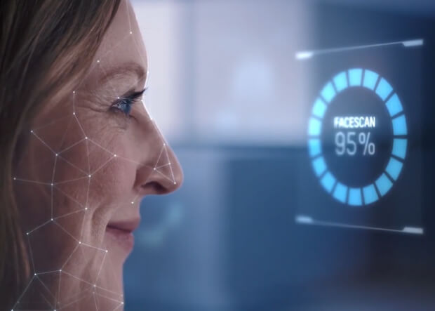
02
IMAGE AUTHENTICATION
ELECTIVE IN ARTIFICIAL INTELLIGENCE
FINAL PROJECT
IMAGE
Implementation of face recognition
AUTHENTICATION

Slide 6



FACE VERIFICATION PROCESS
FACE DETECTION
FACE CAPTURE
FACE MATCH
ELECTIVE IN ARTIFICIAL INTELLIGENCE
FINAL PROJECT

Slide 7
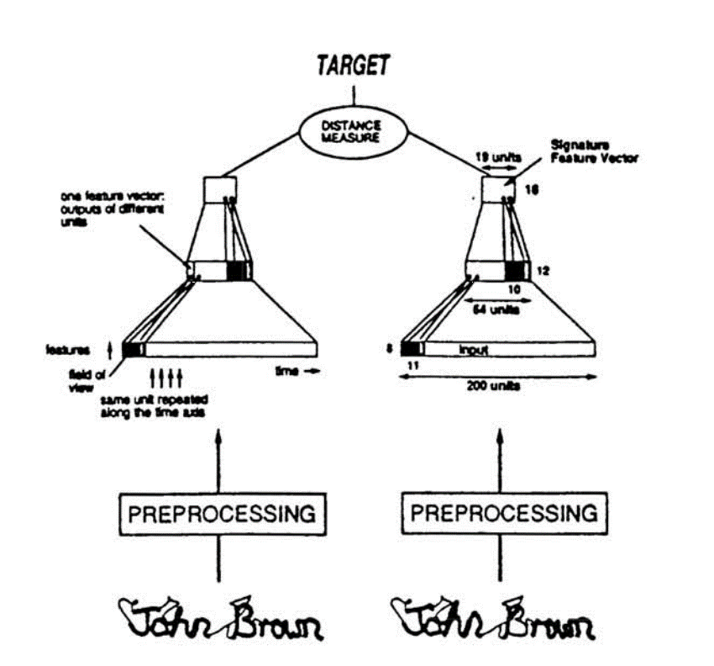
FACE VERIFICATION PROCESS
ELECTIVE IN ARTIFICIAL INTELLIGENCE
FINAL PROJECT
CNN
Siamese Network
One-shot Learning

Slide 8
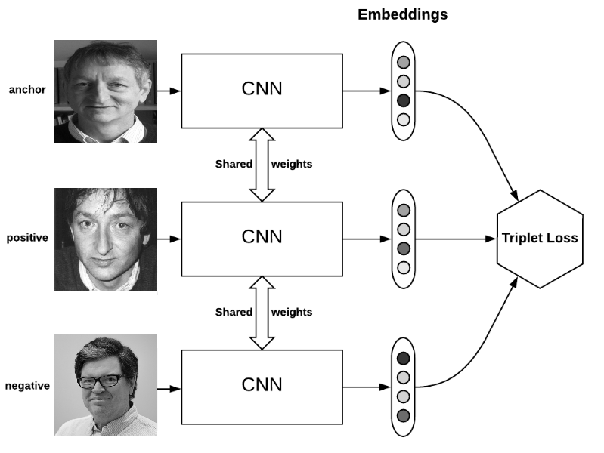
FACE VERIFICATION PROCESS
ELECTIVE IN ARTIFICIAL INTELLIGENCE
FINAL PROJECT
FaceNet
Triplet Loss, SGD, AdaGrad, ReLU
FaceNet provides a unified embedding for face recognition, verification and clustering tasks. It maps each face image into an Euclidean space such that the distances in that space correspond to face similarity.

Slide 9
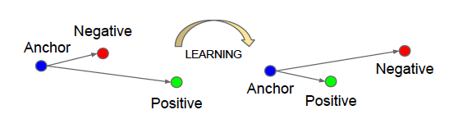
FACE VERIFICATION PROCESS
ELECTIVE IN ARTIFICIAL INTELLIGENCE
FINAL PROJECT
Triplet Loss Function

Slide 10
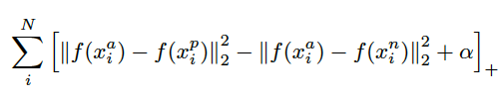
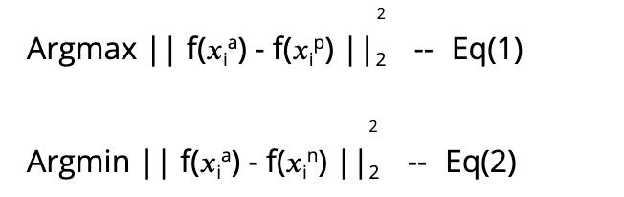
FACE VERIFICATION PROCESS
ELECTIVE IN ARTIFICIAL INTELLIGENCE
FINAL PROJECT
The Distance

Slide 11
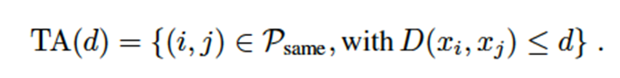
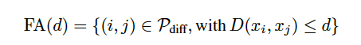
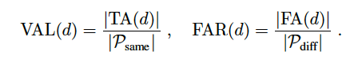
FACE VERIFICATION PROCESS
ELECTIVE IN ARTIFICIAL INTELLIGENCE
FINAL PROJECT
Evaluation
True accepts are the face pairs that were correctly classified as same at threshold ‘d’.
False accepts are the face pairs that were incorrectly classified as same.

Slide 12

03
SPEECH & TEXT
ELECTIVE IN ARTIFICIAL INTELLIGENCE
FINAL PROJECT
SPEECH
Scenario and its explanation
TEXT

Slide 13





LIBRARIES
NLTK
SPACY
PYTHON
gTTS
PLAYSOUND
ELECTIVE IN ARTIFICIAL INTELLIGENCE
FINAL PROJECT
Sentence structures
Tokenizer; POS Tags; Matcher
Execute all!
Google Text To Speech
Play generated speech

Slide 14




SCENARIO
ELECTIVE IN ARTIFICIAL INTELLIGENCE
FINAL PROJECT

Slide 15
SCHEME OF SCENARIO
ELECTIVE IN ARTIFICIAL INTELLIGENCE
FINAL PROJECT
Sign up
Welcome
New user?
Sign in

Slide 16
SCHEME OF SCENARIO
ELECTIVE IN ARTIFICIAL INTELLIGENCE
FINAL PROJECT
Let’s sign the user up
Sure?
Credentials
Glasses?
Login
Exit
Remove

Slide 17
SCHEME OF SCENARIO
ELECTIVE IN ARTIFICIAL INTELLIGENCE
FINAL PROJECT
Let’s check how to sign in:
Check name
Check image
Logged in
Credentials
Glasses
Remove

Slide 18

04
Deep RL Games
ELECTIVE IN ARTIFICIAL INTELLIGENCE
FINAL PROJECT
DEEP RL
Mountain Car with DDPG & Super Mario with DQN
GAMES

Slide 19
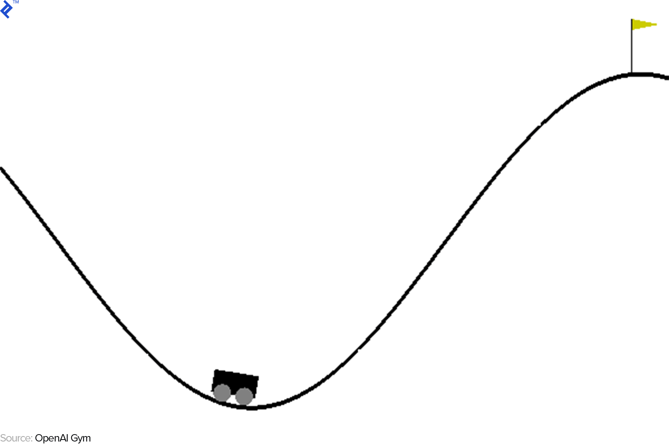

PLANS TO WORK ON
ELECTIVE IN ARTIFICIAL INTELLIGENCE
FINAL PROJECT
Mountain Car
Super Mario
DDPG
DQN

Slide 20
DEEP DETERMINISTIC POLICY GRADIENT
ELECTIVE IN ARTIFICIAL INTELLIGENCE
FINAL PROJECT
a.k.a DDPG
Theory with less equations
Actor & Critic Networks
Target Network
Replay Buffer

Slide 21
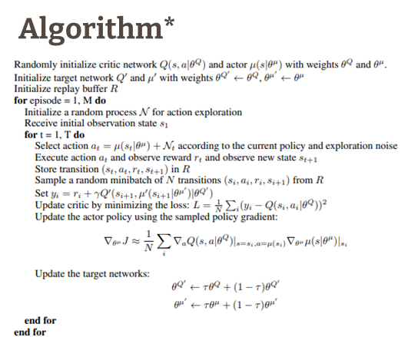



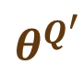
THEORY
ELECTIVE IN ARTIFICIAL INTELLIGENCE
FINAL PROJECT
Parameters we need
$$θ^{Q}$$
$$θ^{μ}$$
Algorithm
Q-Network
Policy Network
$$θ^{Q^{′}}$$
$$θ^{μ^{′}}$$
Target Q-Network
Target Policy Network
*taken from “Continuous Control with Deep Reinforcement Learning”, (Lilicrap et al, 2015)

Slide 22
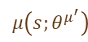
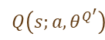
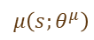
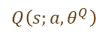
HOW DOES IT WORK?
ELECTIVE IN ARTIFICIAL INTELLIGENCE
FINAL PROJECT
2 Networks:
$$μ\left(s;θ^{μ}\right)$$
$$Q\left(s;a, θ^{Q}\right)$$
Actor
Critic
2 Target Networks:
$$μ\left(s;θ^{μ^{′}}\right)$$
$$Q\left(s;a, θ^{Q^{′}}\right)$$
Target Actor
Target Critic

Slide 23
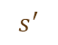



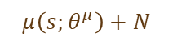

HOW DOES IT WORK (2)?
ELECTIVE IN ARTIFICIAL INTELLIGENCE
FINAL PROJECT
Update of Actor Network
Update of Critic Network
Select Correct Action
$$μ\left(s;θ^{μ}\right)+N$$
$$a$$
$$r$$
Connection between parameters
$$a,s,r,s^{′}$$
$$s$$
$$s^{′}$$
Replay Buffer
Buffer

Slide 24
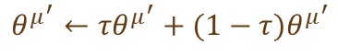
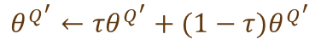
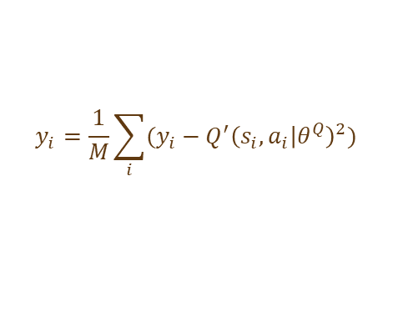
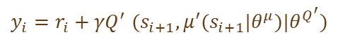
THEN…
ELECTIVE IN ARTIFICIAL INTELLIGENCE
FINAL PROJECT
Sample and Train
$$y_{i}{=r_{i}+γQ}^{′}{(s}_{i+1},μ^{′}(s_{i+1}|θ^{μ})|θ^{Q^{′}})$$
Temporal Difference
$$y_{i}=\frac{1}{M}\sum_{i}{(y_{i}−{Q^{′}\left(s_{i},a_{i} | θ^{Q}\right)}^{2})}$$
Update Critic & Actor
Update Target Critic & Target Actor
$$θ^{Q^{′}}←{τθ}^{Q^{′}}+(1−τ)θ^{Q^{′}}$$
$$θ^{μ^{′}}←{τθ}^{μ^{′}}+(1−τ)θ^{μ^{′}}$$

Slide 25
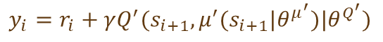
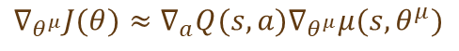
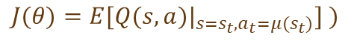
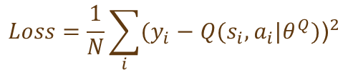
NETWORK UPDATES (Actor & Critic)
ELECTIVE IN ARTIFICIAL INTELLIGENCE
FINAL PROJECT
Updated Q-value:
$$y_{i}=r_{i}+γQ^{′}(s_{i+1},μ^{′}(s_{i+1}|θ^{μ^{′}})|θ^{Q^{′}})$$
Loss computation:
$$Loss=\frac{1}{N}\sum_{i}{{(y_{i}−Q(s_{i},a_{i}|θ^{Q})\text{)}}^{2}}$$
Expected Return:
$$J(θ)=E[Q(s,a)|_{s=s_{t},a_{t}=μ(s_{t})}] )$$
For policy loss:
$$∇_{θ^{μ}}J(θ)≈∇_{a}Q(s,a)∇_{θ^{μ}}μ(s,θ^{μ})$$

Slide 26


REST DETAILS
ELECTIVE IN ARTIFICIAL INTELLIGENCE
FINAL PROJECT
Brief Information about Mountain Car
Implementation

Slide 27
DEEP Q - NETWORK
ELECTIVE IN ARTIFICIAL INTELLIGENCE
FINAL PROJECT
a.k.a DQN
AI and ML algorithms widely used to play computer games
It is helpful to get valuable observations that can be made on ML pattern
Reinforcement learning is one widely-studied and promising ML method

Slide 28
What are we going to build
ELECTIVE IN ARTIFICIAL INTELLIGENCE
FINAL PROJECT
We study how to construct an RL Mario controller agent
Achieve better accuracy so agent can learn from game environment
One of difficulties is to define state, action and reward
We will have enemies, modes, items, and all these affect to agent

Slide 29
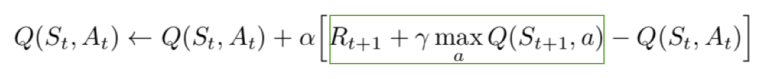
What are we going to use?
ELECTIVE IN ARTIFICIAL INTELLIGENCE
FINAL PROJECT
We will use Q-learning algorithm to evolve the decision strategy
It treats the learning environment as a state machine
It maintains a value of expected total reward
For each action, a reward will be given and Q-value is updated

Slide 30
IMPLEMENTATION DETAILS
ELECTIVE IN ARTIFICIAL INTELLIGENCE
FINAL PROJECT
We will use Tensorflow to train and test our Mario agent
We will plan to make around 1000 epochs to train the model
By adding the state and checking the rewards we will update the trained model

Slide 31

THANKS!
Do you have any questions?
ELECTIVE IN ARTIFICIAL INTELLIGENCE
FINAL PROJECT
Notes:
Thanks guys!

